Slide 5
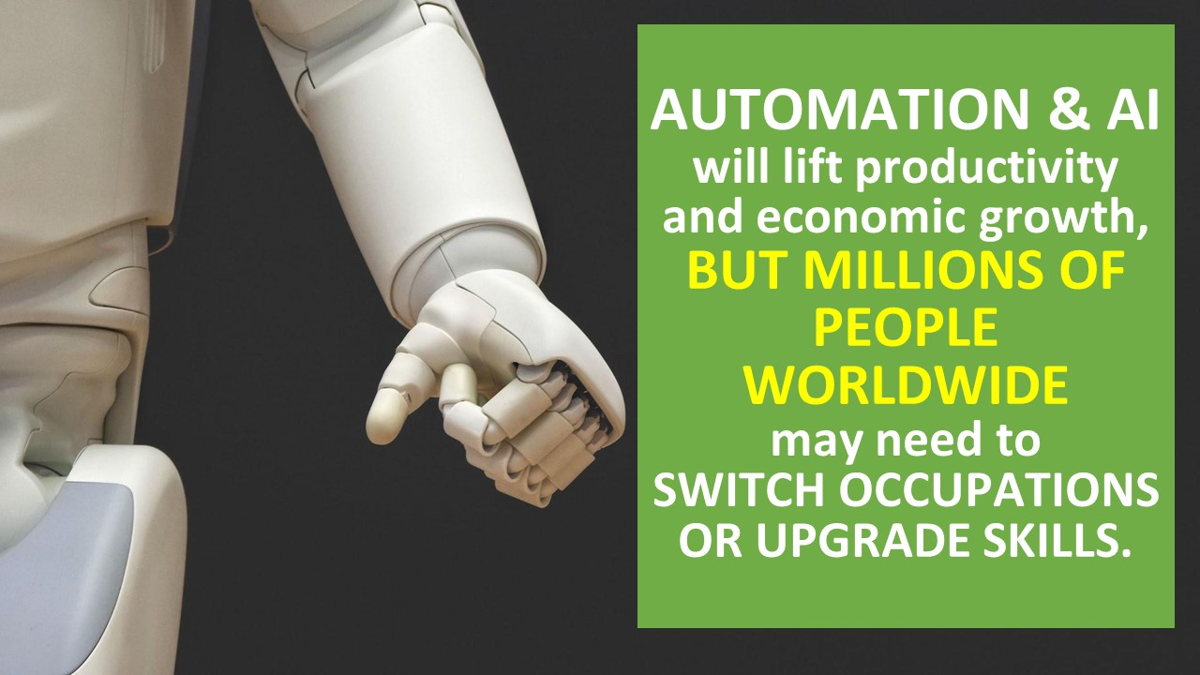

Slide 26
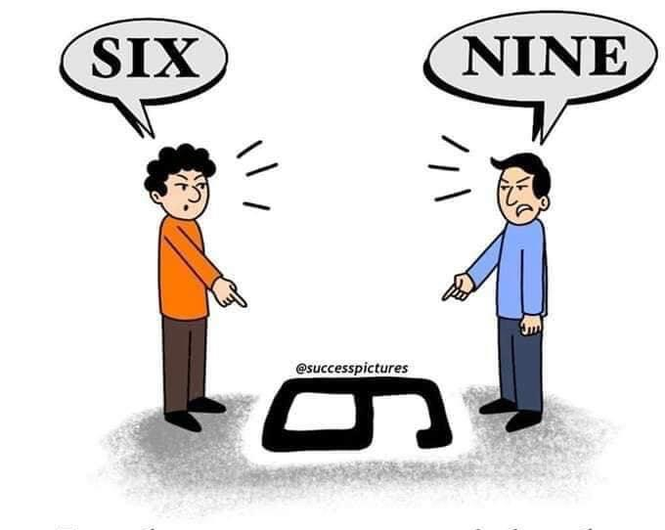
Just because
YOU ARE RIGHT
, does not mean,
I AM WRONG.
You Just haven’t seen life from
MY SIDE
...

Slide 27
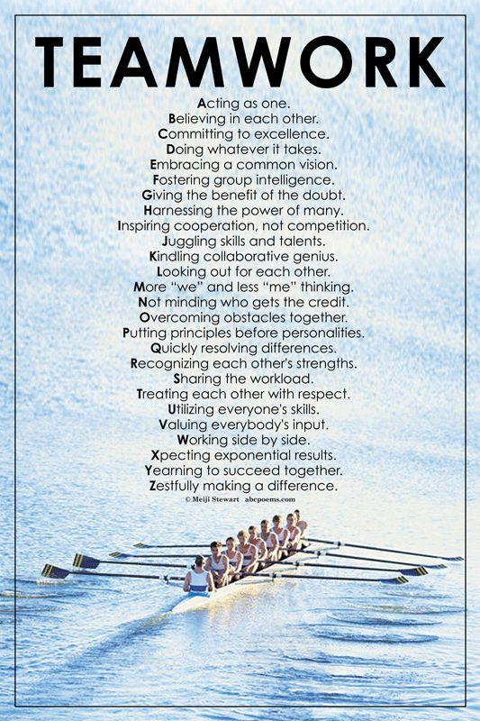

Slide 28
Be a
RISK
Taker

Slide 29
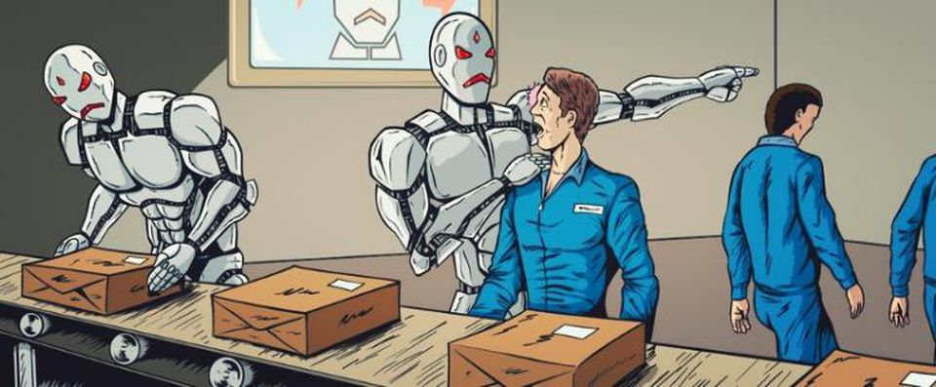
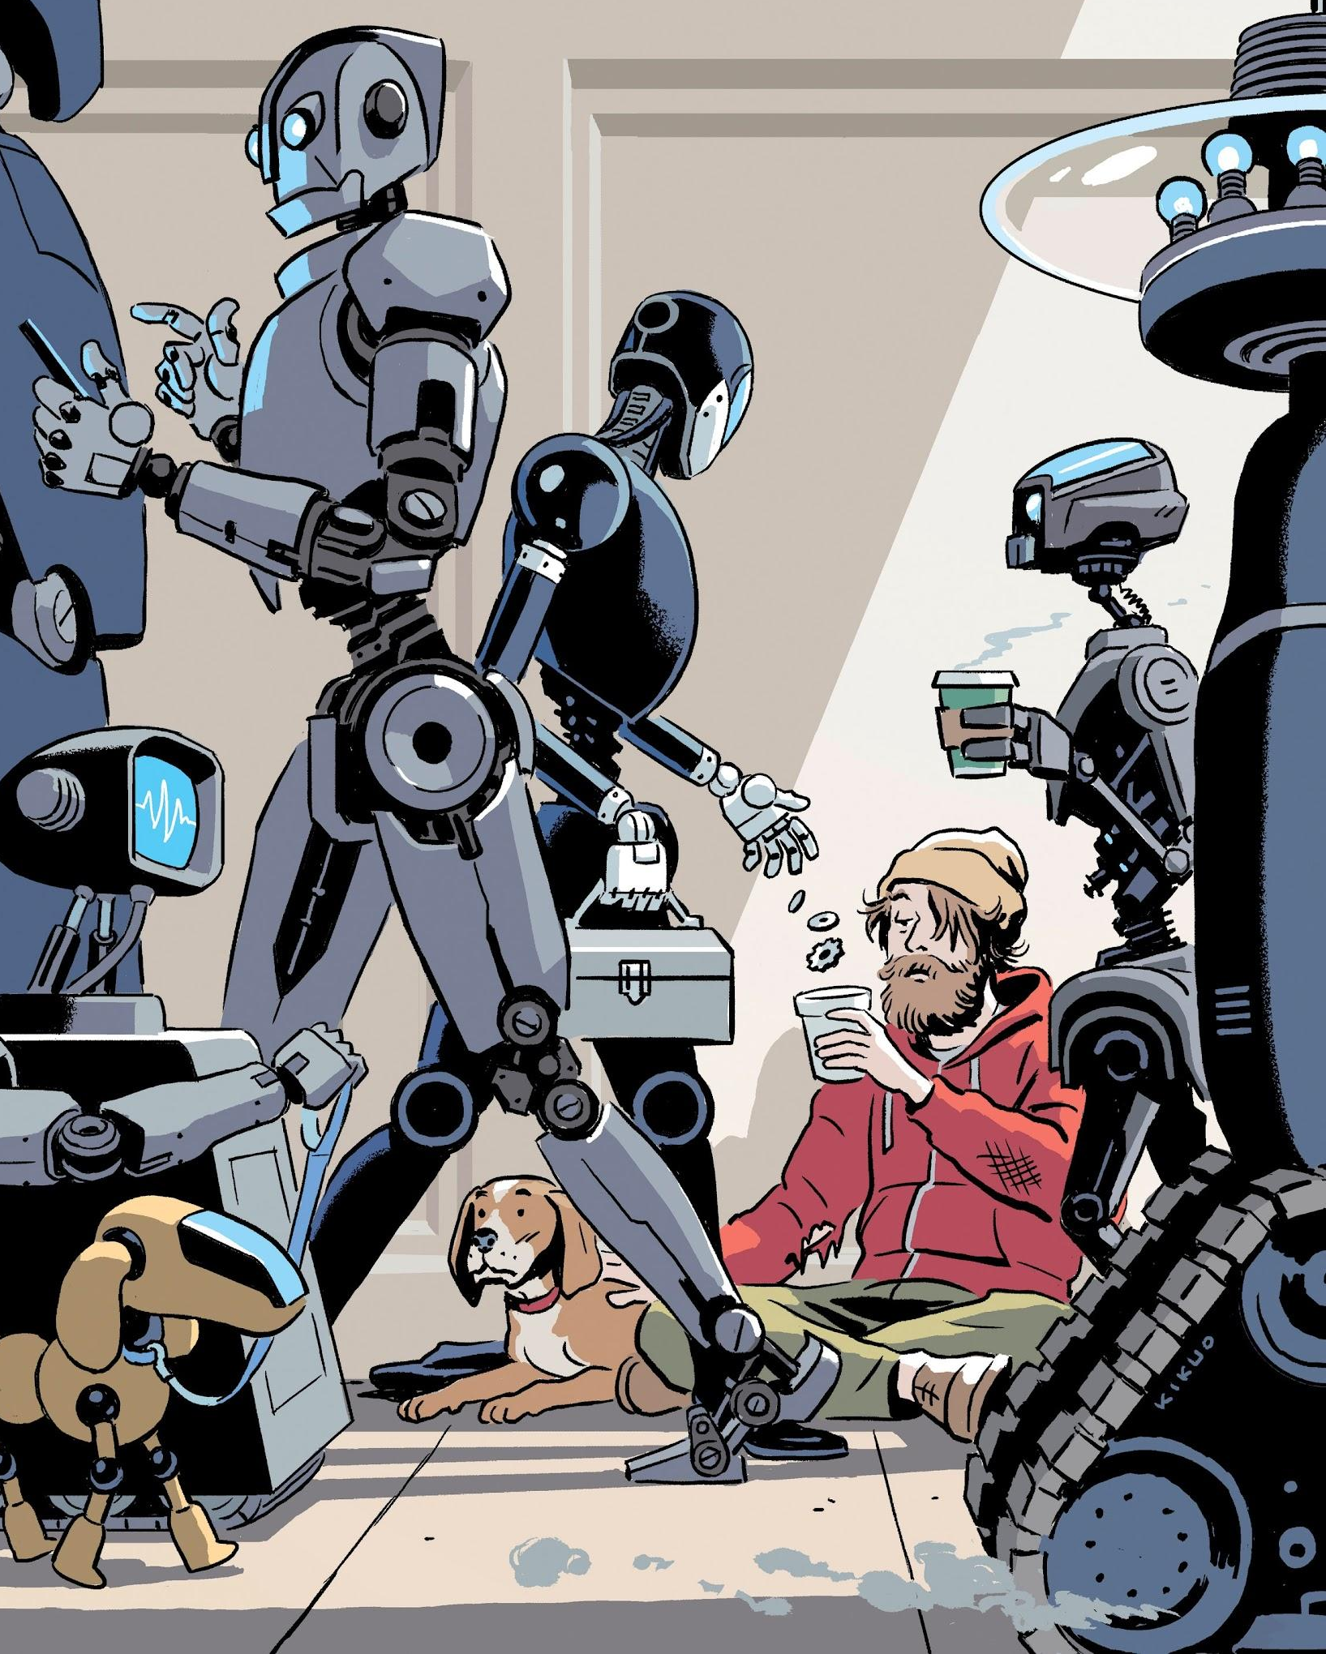
Caution⚠️
If we are not prepared, then Technology will dominate. Need joint (Industry- Academia) efforts to prepare for Future!

Slide 30
Lastly,
You can tune more for LEADERSHIP
on

Slide 31
QUESTION AND ANSWER

Slide 32
Thank You!!!

